Slide 1
Unit 5

Slide 2
Problems related to CpU, Motherboard, Input/output devices

Slide 3
1)Keyboard
There are several problems you can encounter with a keyboard
Some Letters Won't Type
Buttons Are Sticking

Slide 4
Numbers Won't Type
Letters Are Typing Numbers

Slide 5
Typing Over Letters
Cursor Is Jumping

Slide 6
LASER PRINTER ISSUES

Slide 7
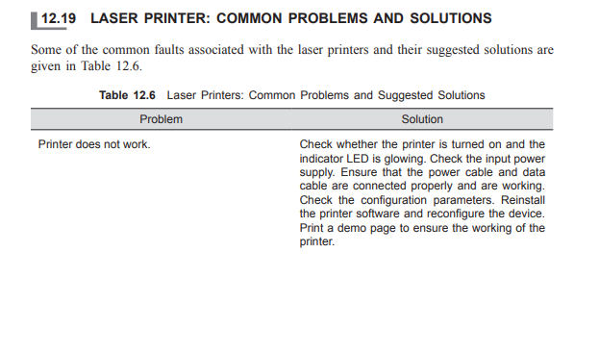

Slide 8
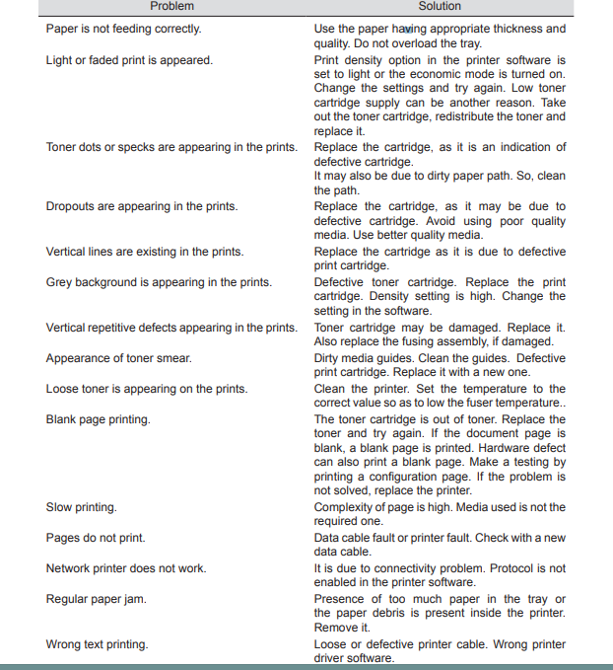

Slide 9
Cpu issues

Slide 10
computers won’t load the operating system if an essential component like a CPU is not working.
In other words, the usual boot up process can’t be completed as POST or Power-On Self-Test will indicate that a critical component is missing in the system.
Other components such as fans, hard drive, and the motherboard in general will continue to work but the boot up process will eventually end up in a blue screen of death error.

Slide 11
Lock ups and overheating immediately before PC shuts down.
Beeping.
Charred motherboard or CPU.

Slide 12
Motherboard

Slide 13
Common symptoms of Motherboard failure is one of the most challenging issues any user or technician can face simply because there are a number of variables to consider.
To get down to the bottom of the issue, a technician will usually have to eliminate several software and hardware causes.

Slide 14
Usually, there are not many signs to come by to help you diagnose a motherboard failure.

Slide 15
Physically damaged parts.
Look out for unusual burning odor
Random lock ups or freezing issues.
Blue screen of death

Slide 16
Reasons why a motherboard fails
below are some of the common reasons why a motherboard can stop working:
•Overheating.
•Fan failure. Dust can accumulate very fast in fans causing them to fail. Make sure that you clean the fans inside the tower at least once every year.
•Too much dust in the system. Dust, like heat, can shorten component lifespan and the motherboard in general.
•Smoke
•Accidental drop that subjects components to unnecessary shock.
•Aging
•Power surges or unstable voltage.

